Slide 1
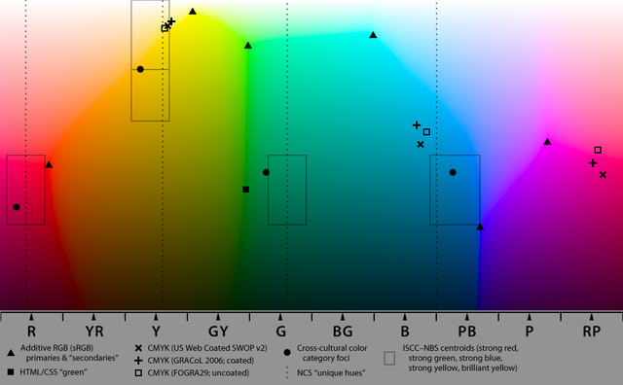
Case Project
Wine Dataset

Slide 2
The Dataset
Wine Quality - Red Wine Dataset
This dataset contains various physicochemical properties and quality ratings for red wine samples. The features (fixed acidity, volatile acidity, citric acid, etc.) are used to predict the quality of the wine, which is rated on a scale from 0 to 10. Each column represents a different aspect of the wine's composition or its assessed quality.

Slide 3
Dataset Description
1. Fixed Acidity (fixed acidity)
o Description: Fixed acids are non-volatile acids that do not evaporate easily.
o Units: grams per liter (g/L)
2. Volatile Acidity (volatile acidity)
o Description: Volatile acids can evaporate and contribute to the wine's aroma and taste.
o Units: grams per liter (g/L)
3. Citric Acid (citric acid)
o Description: Citric acid is a weak organic acid that adds freshness and flavor to the wine.
o Units: grams per liter (g/L)
4. Residual Sugar (residual sugar)
o Description: Residual sugar is the amount of sugar remaining after fermentation stops.
o Units: grams per liter (g/L)

Slide 4
5. Chlorides (chlorides)
o Description: Chlorides represent the amount of salt in the wine.
o Units: grams per liter (g/L)
6. Free Sulfur Dioxide (free sulfur dioxide)
o Description: Free sulfur dioxide is the amount of SO2 that is not bound and is available to act as an antimicrobial and antioxidant.
o Units: milligrams per liter (mg/L)
7. Total Sulfur Dioxide (total sulfur dioxide)
o Description: Total sulfur dioxide includes both bound and free forms of SO2.
o Units: milligrams per liter (mg/L)
8. Density (density)
o Description: Density is the mass per unit volume of the wine, influenced by the amount of sugar and alcohol.
o Units: grams per cubic centimeter (g/cm³)

Slide 5
9. pH (pH)
o Description: pH measures the acidity or alkalinity of the wine. Lower pH values indicate higher acidity.
o Units: pH scale (dimensionless)
10. Sulphates (sulphates)
o Description: Sulphates are added to wine to prevent spoilage and oxidation.
o Units: grams per liter (g/L)
11. Alcohol (alcohol)
o Description: The alcohol content of the wine.
o Units: percentage by volume (% vol)
12. Quality (quality)
o Description: The quality score of the wine, typically based on sensory data (taste, aroma, etc.).
o Units: score (integer scale from 0 to 10)

Slide 6
Problem Statements
1. What is the most frequently occurring wine quality? What is the highest number in and the lowest number in the quantity column?
2. How is `fixed acidity` correlated to the quality of the wine? How does the alcohol content affect the quality? How is the `free Sulphur dioxide` content correlated to the quality of the wine?
3. What is the average `residual sugar` for the best quality wine and the lowest quality wine in the dataset?
4. Does `volatile acidity` have an effect over the quality of the wine samples in the dataset?
5. Train a Decision Tree model and Random Forest Model separately to predict the Quality of the given samples of wine. Compare the Accuracy scores for both models.

Slide 7
Data Preprocessing
Loaded the Dataset Read the wine_data.csv file using pandas.
Handled Missing Values Checked for missing values using dataset.isnull().sum(). No imputation was explicitly done (likely no missing values).
Removed Duplicates Used dataset.drop_duplicates() to eliminate duplicate rows.

Slide 8
Most frequently occurring wine quality and Highest and Lowest number in the quality column
Found the Most Frequent Wine Quality Used dataset['quality'].value_counts() to count occurrences of each wine quality. Identified the most frequent quality. Found the Highest & Lowest Wine Quality Used dataset['quality'].max() to get the highest wine quality. Used dataset['quality'].min() to get the lowest wine quality.
Most frequently occurring wine quality = 5
Highest Quality = 8
Lowest Quality = 3

Slide 9
Correlation of fixed acidity, alcohol content, and free Sulphur dioxide to the quality of the wine
Calculated Correlation Coefficients
Used dataset.corr() to check relationships between variables. Extracted the correlation values of fixed acidity, alcohol, and free sulfur dioxide with quality.
Fixed Acidity correlation with quality = 0.11902366561349675
Alcohol correlation with quality = 0.48034289800155505
Free Sulfur Dioxide correlation with quality = -0.050462766805025684
A slight increase in wine quality is associated with higher fixed acidity, but the relationship is not strong. Higher alcohol content tends to be linked with better wine quality. Free sulfur dioxide has almost no correlation with wine quality, meaning it does not significantly impact the quality.

Slide 10
Average residual sugar for the best quality wine and the lowest quality wine
Identified the Best & Lowest Quality Wines
Used dataset['quality'].max() to get the highest quality. Used dataset['quality'].min() to get the lowest quality. Filtered the Dataset Based on Quality Selected rows where quality == highest and calculated the average residual sugar. Selected rows where quality == lowest and calculated the average residual sugar. Compared Residual Sugar Values Determined whether higher-quality wines have more or less residual sugar.
Average residual sugar for the best quality wine = 2.576470588235294
Average residual sugar for the lowest quality wine = 2.6350000000000002
This indicates that residual sugar does not significantly vary between the highest and lowest quality wines.

Slide 11
Effect of volatile acidity over the quality of the wine samples
Calculated the Correlation Between Volatile Acidity and Quality
Used dataset.corr() to check the correlation between volatile acidity and quality.
Volatile Acidity Correlation with Quality = -0.39521368900984055
The correlation between volatile acidity and quality is -0.391, indicating a moderate negative correlation. This means that as volatile acidity increases, wine quality tends to decrease. High volatile acidity can give wine an undesirable sharp or sour taste, which might explain the negative impact on quality.

Slide 12
Decision Tree Model & Random Forest Model
Separated features (X) and target variable (y). Split data into training & test sets (train_test_split with 25% test size). Applied StandardScaler to normalize the feature values.
1) Decision Tree Model
Trained a Decision Tree Model Predicted Wine Quality
Visualised the model Evaluated Accuracy using a confusion matrix

Slide 13
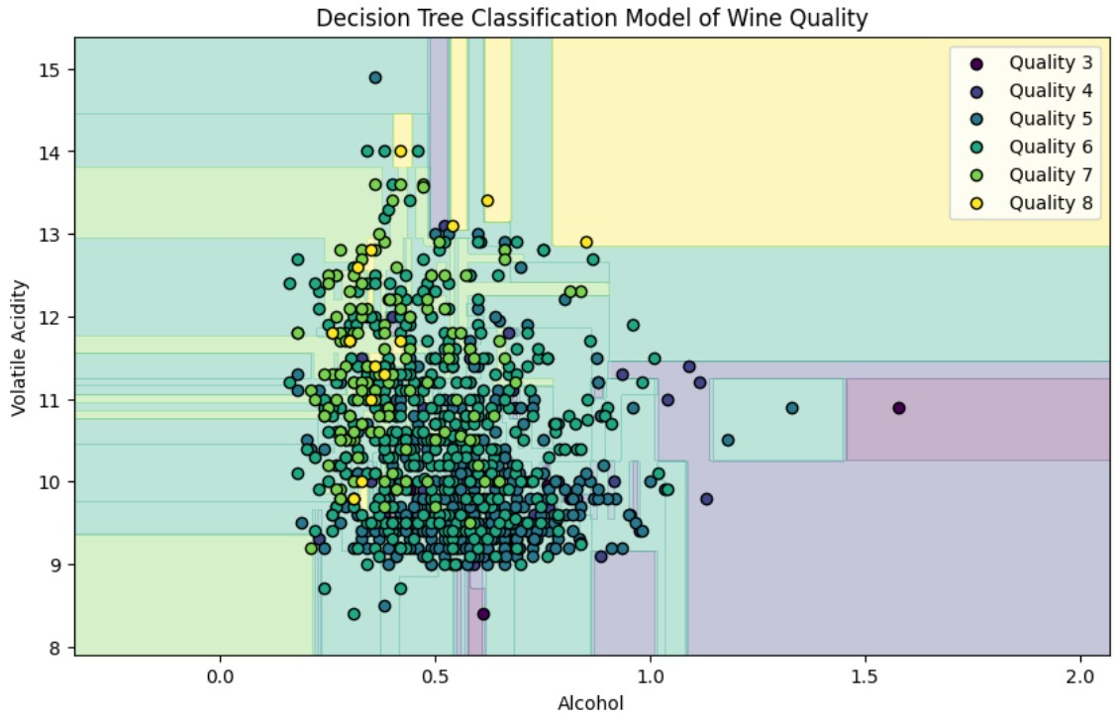
Decision Tree Model Visualisation

Slide 14
2) Random Forest Model Trained a Random Forest Model Predicted Wine Quality
Visualised the model Evaluated Accuracy using a confusion matrix

Slide 15
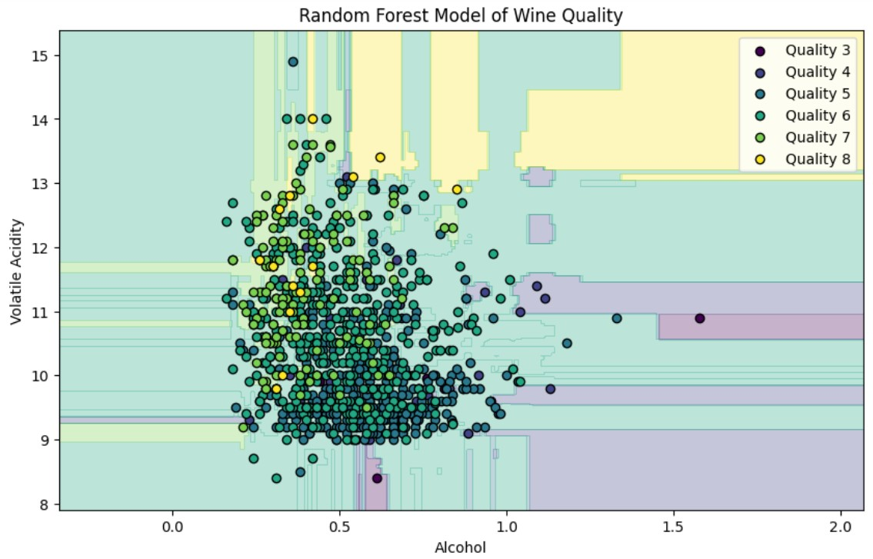
Random Forest Model Visualisation

Slide 16
Accuracy scores for both models
The accuracy of both models:
Decision Tree = 50%
Random Forest = 54.41176470588235%
The accuracy results (50% - 55%) suggest that both Decision Tree and Random Forest models are not performing very well on this dataset.

Slide 17
Thank You

